Slide 1
Animating Sand as a Fluid
Milestone Presentation

Slide 2
Project Scope
Using PIC/FLIP solver (intended for fluid simulations) to simulate sand
Augment the solver to capture/demonstrate physical properties of sand
Milestone goal: Implementation of a fluid solver
Simulation of particles within a domain that exhibit properties of a fluid

Slide 3
Approach (Pipeline)
1. Staggered grid init
2. (NN averaging) Splatting Kernel (Particles ➔ Grid)
3. Apply Forces (Gravity)
4. Pressure solving: Gauss-Seidel (incompressibility constraint)
5. Trilinear Interpolation (Grid ➔ Particles)
6. Advection: Runge-Kutta 2, (Explicit Euler)

Slide 4
Challenges
Boundary Conditions (Neumann) ⬄ End of simulation domain
Interaction between non-fluid and fluid
Particles must fall equally (See video in next slide)

Slide 5
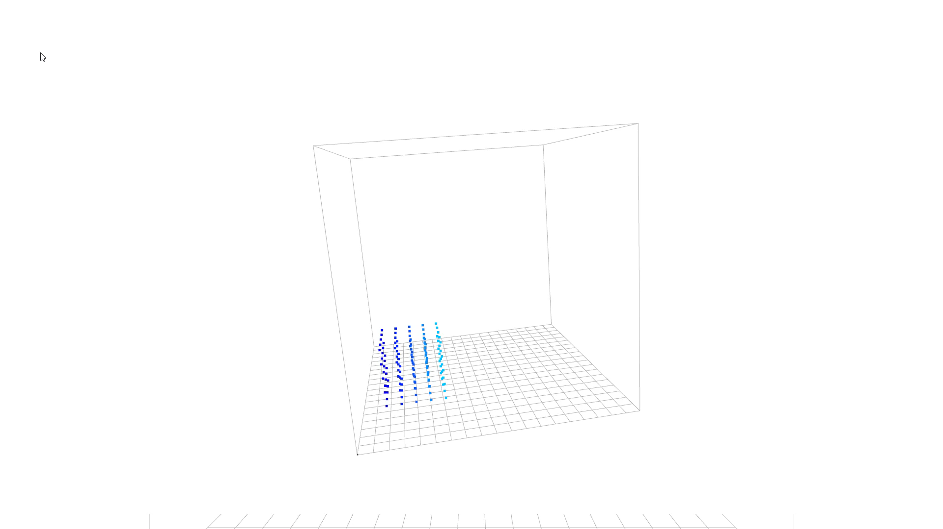

Slide 6
Simulation parameters
Parameter | Value
Domain size | 20 x 20 x 20
Voxel size | 1
# of particles | 125
Applied Forces (Gravity) | -9.81
Time step size (per frame) | 0.3

